Slide 1
pycalphad and ESPEI Workshop ESPEI
CALPHAD XLVII

Slide 2
Why develop CALPHAD software tools?
Better science
Develop new thermodynamic models
Improve and share methods as a community
Scripting: get more work done and be able to reproduce it
Integration
Use standard tools in a huge Python ecosystem
Create calculation and data pipelines
Traverse length and time scales
Hierarchical models, machine learning
Free
Freedom: share your work (or don’t)
Cost: lower the barrier for entry
pycalphad
Notes:
Emphasize:
Compose-able framework:
* swap pieces out
* stop reinventing the wheel,
* get more people to use your work => citations

Slide 3
Why develop CALPHAD software tools?
Calculation software is NOT
the whole picture!
Databases and custom models come from somewhere
Better science
Develop new thermodynamic models
Improve and share methods as a community
Scripting: get more work done and be able to reproduce it
Integration
Use standard tools in a huge Python ecosystem
Create calculation and data pipelines
Traverse length and time scales
Hierarchical models, machine learning
Free
Freedom: share your work (or don’t)
Cost: lower the barrier for entry
pycalphad
Notes:
Emphasize:
Compose-able framework:
* swap pieces out
* stop reinventing the wheel,
* get more people to use your work => citations

Slide 4
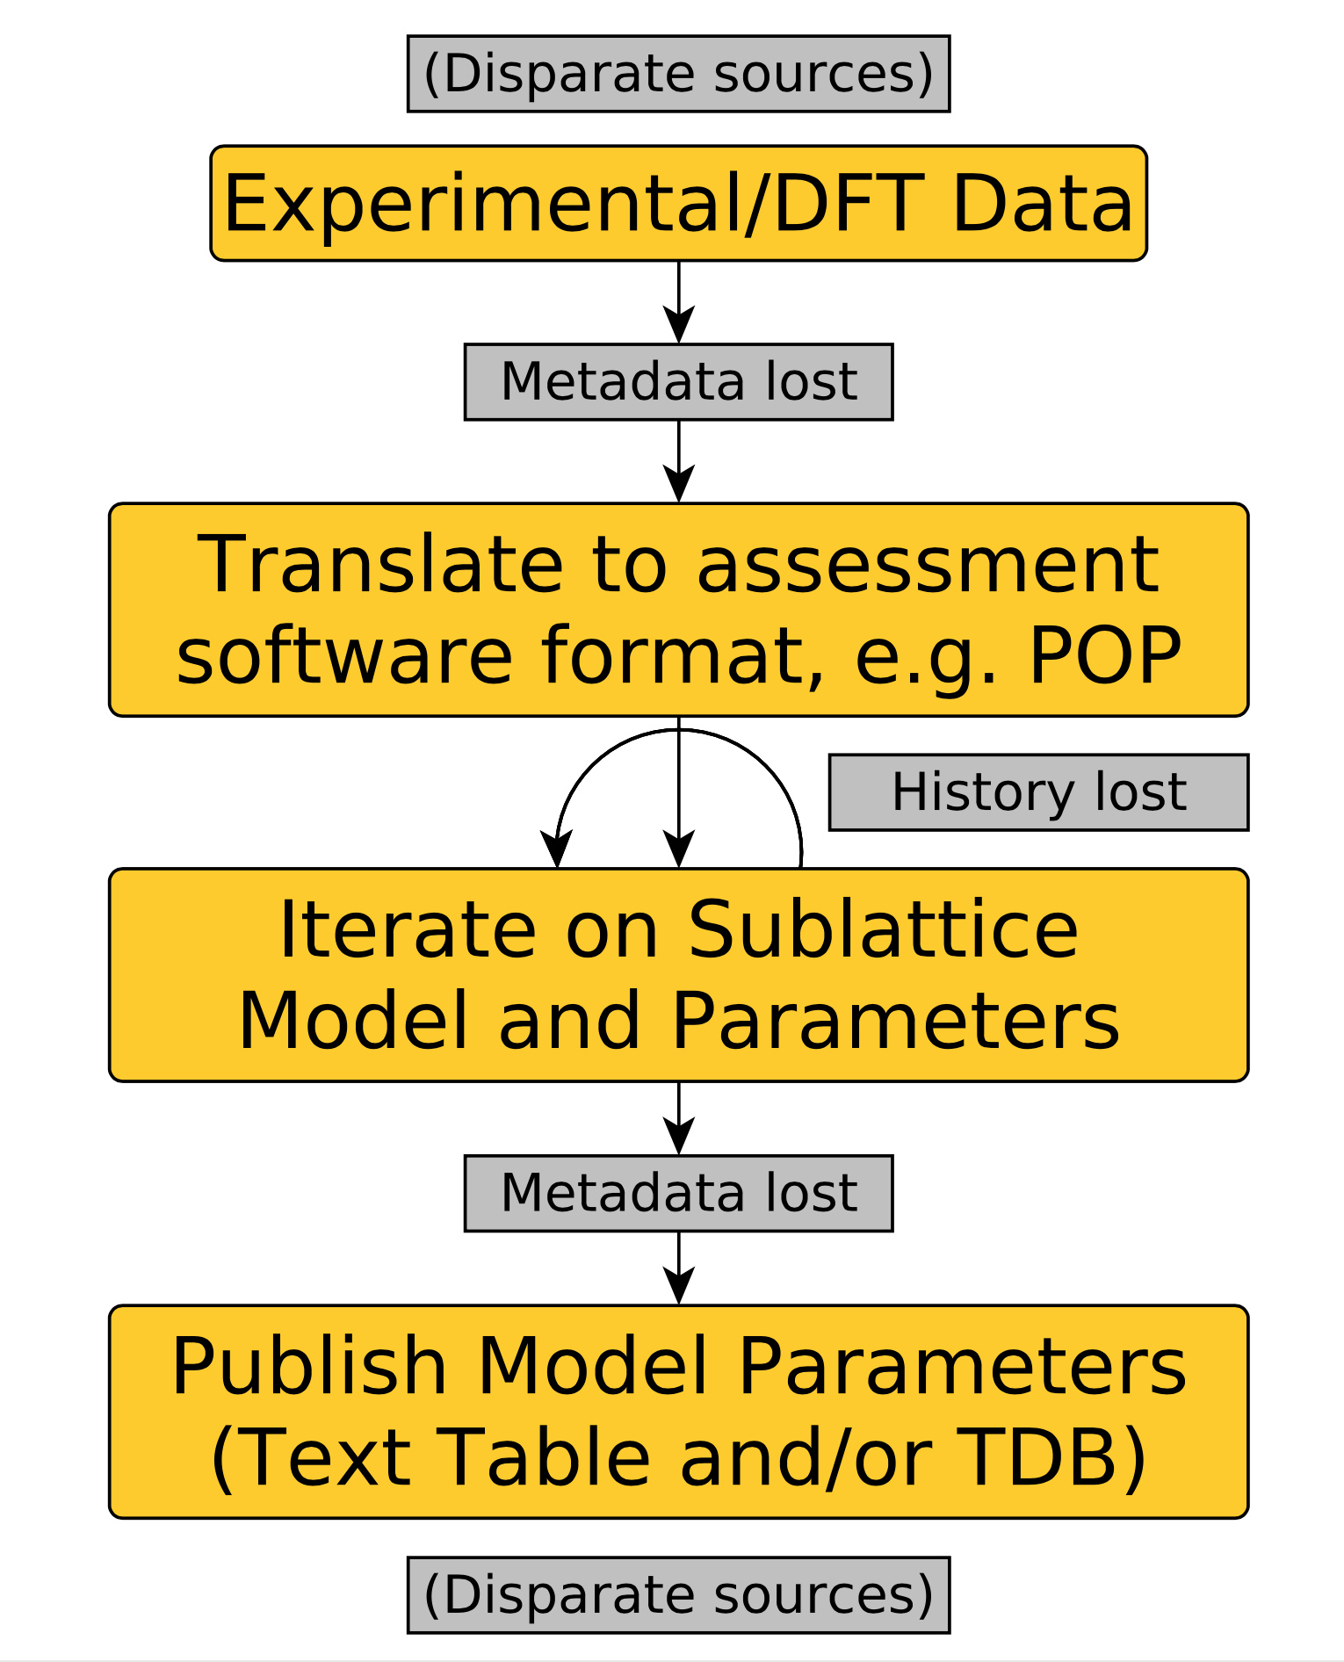
Model for traditional database development
Ternary and multi-component systems
Binary systems
Unary
Otis (2016).

Slide 5
Established methods are effective, but have pain points
Data formats can lead to ambiguity
“Should the experiment be `T` or `X`? ”
How long does it take to understand a file someone else created?
Critically assessed data is closely guarded
Maintenance and re-optimization prevents new models from being tested and adopted => n^{th} generation of databases
pycalphad

Slide 6
We need better modeling tools too
DRY principle: Don’t Repeat Yourself
We need better tools for rapid (re)assessment of new models
Our tools should tell us
Where our models might make bad predictions
How we should spend our time doing experiments and calculations

Slide 7
We need better modeling tools too
Solution: ESPEI
Extensible Self-optimizing Phase Equilibria Infrastructure
2 step approach:
Rapidly generate model parameters
Automatically optimize parameters simultaneously
Quantify uncertainty to make us better modelers
DRY principle: Don’t repeat yourself!
We need better tools for rapid (re)assessment of new models
While we’re at it, our tools should tell us
Where our models might make bad predictions
How we should spend our time doing experiments and calculations

Slide 8
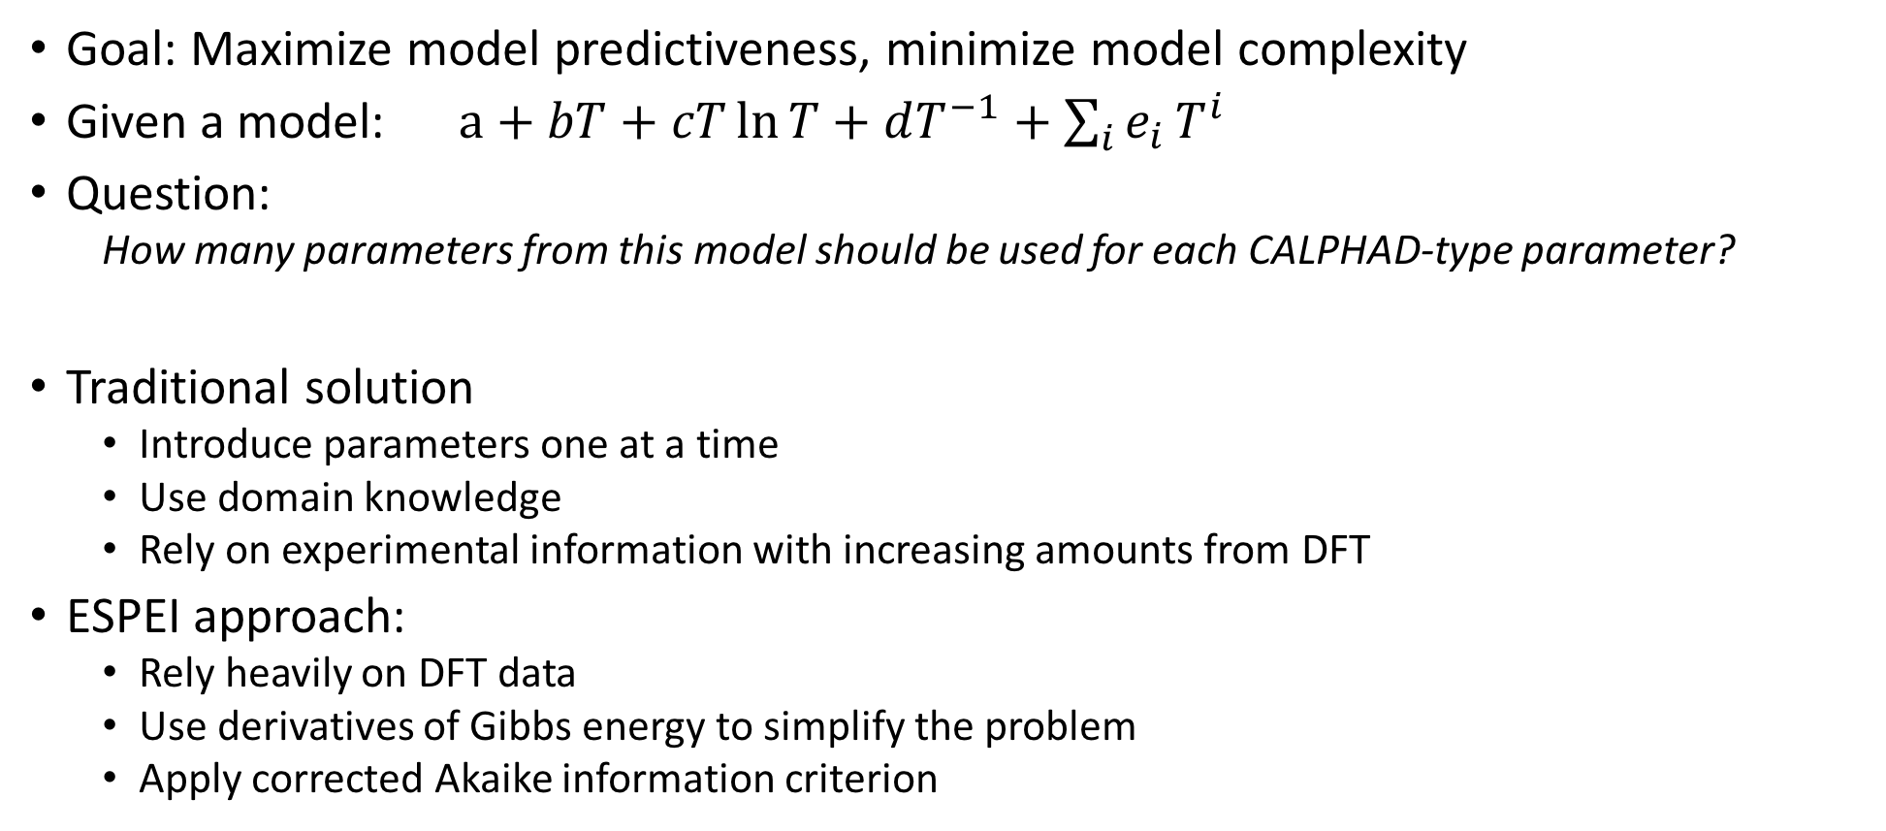
Parameter selection
Goal: Maximize model predictiveness, minimize model complexity
Given a model: $a+bT+cT\ln{T}+dT^{−1}+\sum_{i}{e_{i}}T^{i}$
Question:
How many parameters from this model should be used for each CALPHAD-type parameter?
Traditional solution
Introduce parameters one at a time
Use domain knowledge
Rely on experimental information with increasing amounts from DFT
ESPEI approach:
Rely heavily on DFT data
Use derivatives of Gibbs energy to simplify the problem
Apply corrected Akaike information criterion

Slide 9
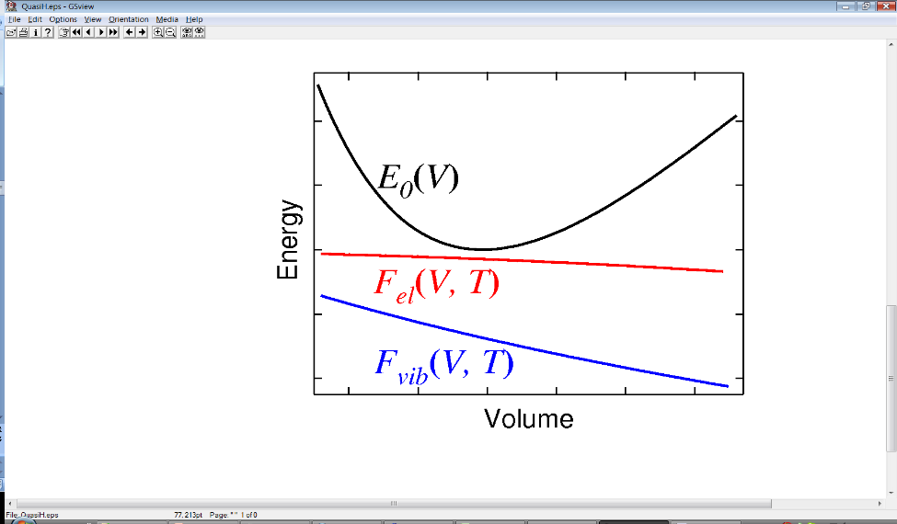
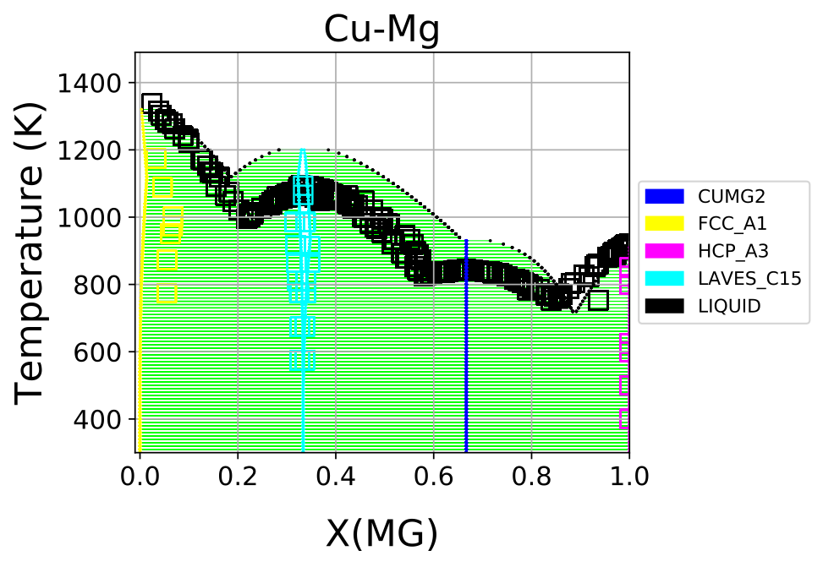
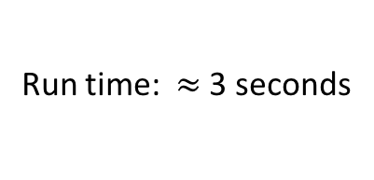
Parameter selection example: Cu-Mg phase diagram from single phase data
ESPEI
Parameter Selection
H_{mix} fcc
Run time: $≈$3 seconds
X(MG)

Slide 10
Ensemble Markov Chain Monte Carlo
Goal of MCMC: find probability distribution for parameters
Bayesian statistics method
Start from a prior that is based on the current TDB
Construct a Markov chain of possible parameter values
For more on this come to our demo or Brandon’s talk

Slide 11
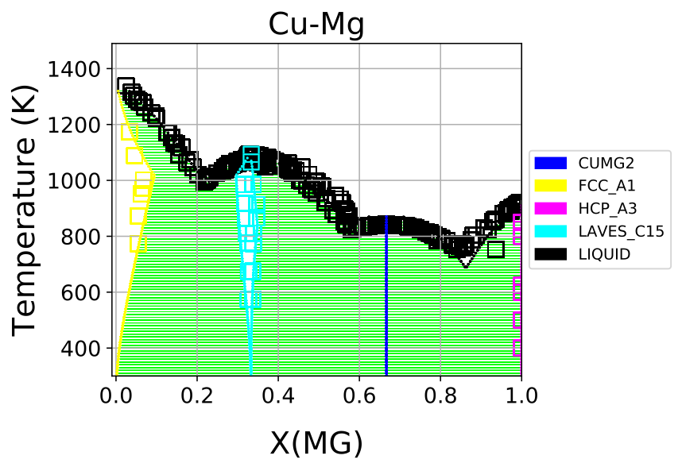
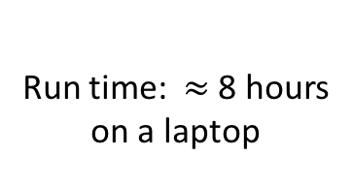
MCMC example: Cu-Mg phase diagram
ESPEI
MCMC
Run time: $≈$8 hours
on a laptop

Slide 12
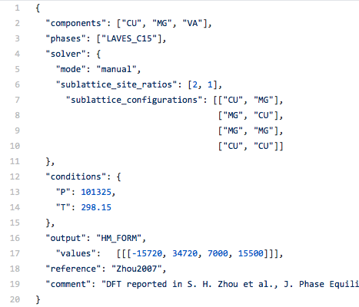
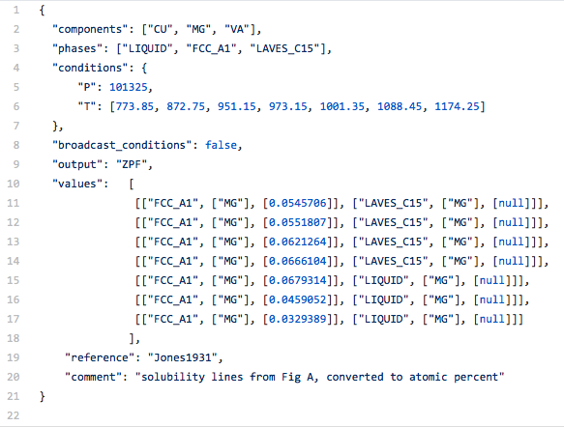
ESPEI datasets
Critically assessed data is key to obtaining good results
Data is digitized in JSON, a machine and human readable format
Single phase data
ZPF data

Slide 13
ESPEI datasets
Some digitized data freely available at
https://github.com/PhasesResearchLab/ESPEI-datasets
Contributions, fixes and suggestions are welcome
Specification and guide for writing ESPEI datasets
http://espei.org/en/latest/input_data.html
Prototype digitization of POP files to Python dictionaries
Used at Citrine Informatics
Conversion to ESPEI JSON coming soon
https://github.com/PhasesResearchLab/popparsing
http://popparsing.readthedocs.io/
We’d love suggestions and for you to report failures

Slide 14
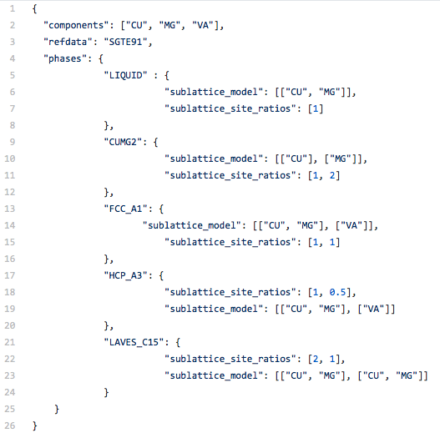
Description of the phase models

Slide 15
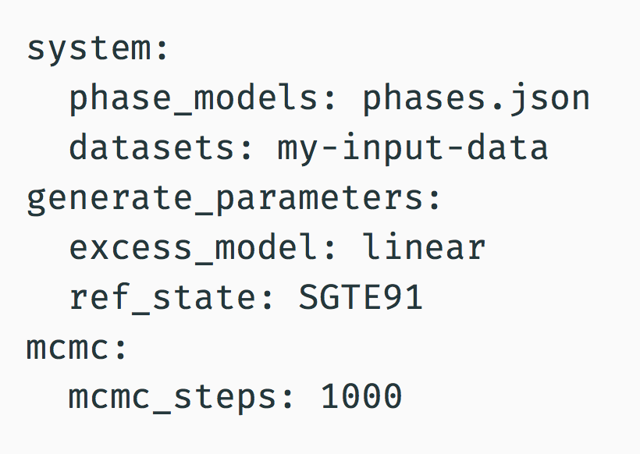
Running ESPEI: File based inputs
Can do parameter generation, mcmc, or both
Parameter generation
SGTE91 reference state provided
Easy to add other unary reference states
Choose an excess model (currently linear only)
MCMC
Restart from previous run
Use MPI on a cluster
Many more customization options...
Example of minimal input for a full run

Slide 16
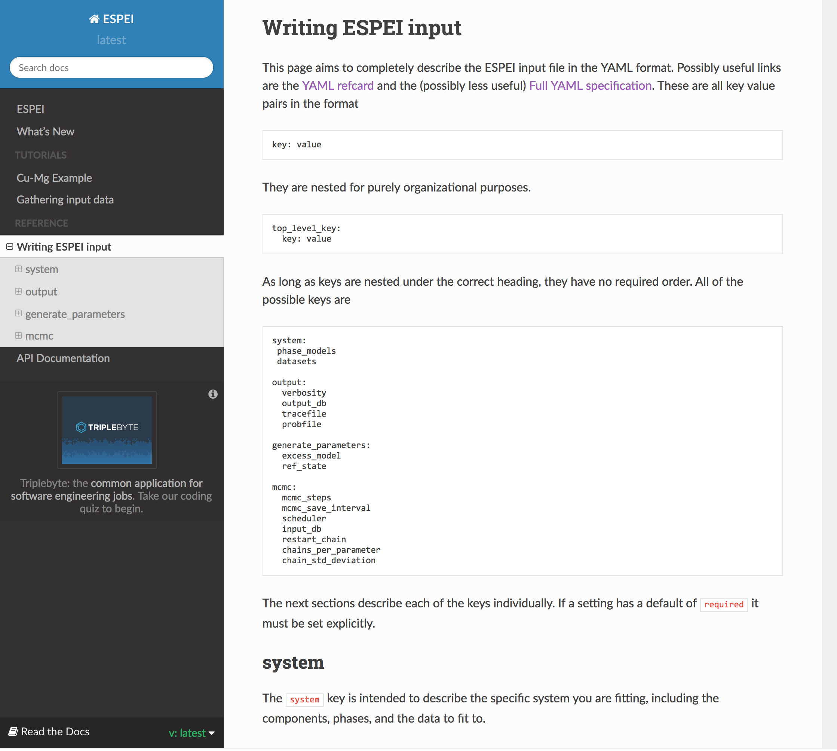
Running ESPEI: File based inputs Fully documented online
https://espei.org

